Slide 1
The Project About Nothing

Slide 2
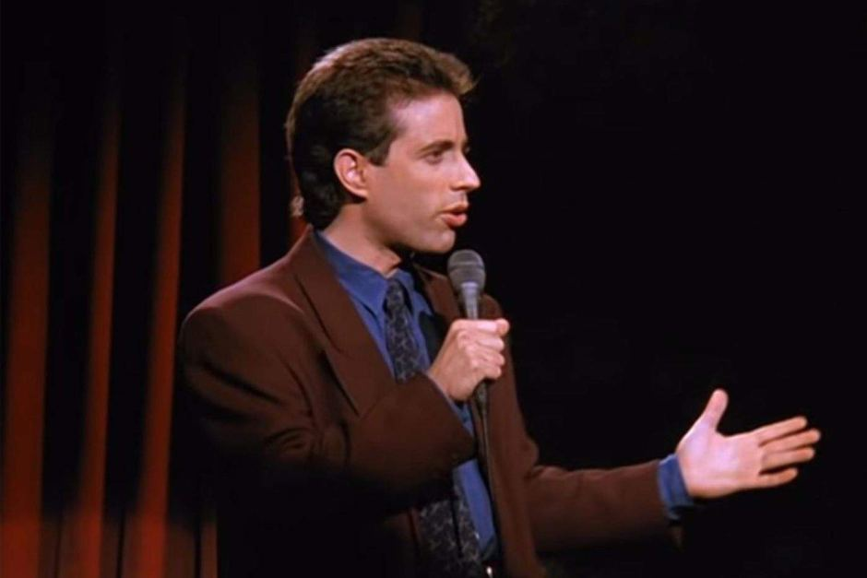

What is the deal with this project?
(NBC, 1989 – 1998)
This "show about nothing" changed the way sitcoms were written, structured, and filmed
One of the only sitcoms in television history to end its run in the top of the ratings
"Yada, yada, yada" "No soup for you!" Festivus, "Close-talker," "low-talker," "high-talker," "shrinkage"

Slide 3
Why do we care?
Seinfeld has stood the test of time
Streaming on Hulu since 2015, and racking up millions of views per year
Average Seinfeld viewer on Hulu is 27 years old – Making them 2nd graders when the series finale aired in 1998
Analyzing a wildly popular show like Seinfeld can give insights to what makes a show good, what TV viewers like, and how Seinfeld has influenced television in the 30+ years since its debut

Slide 4
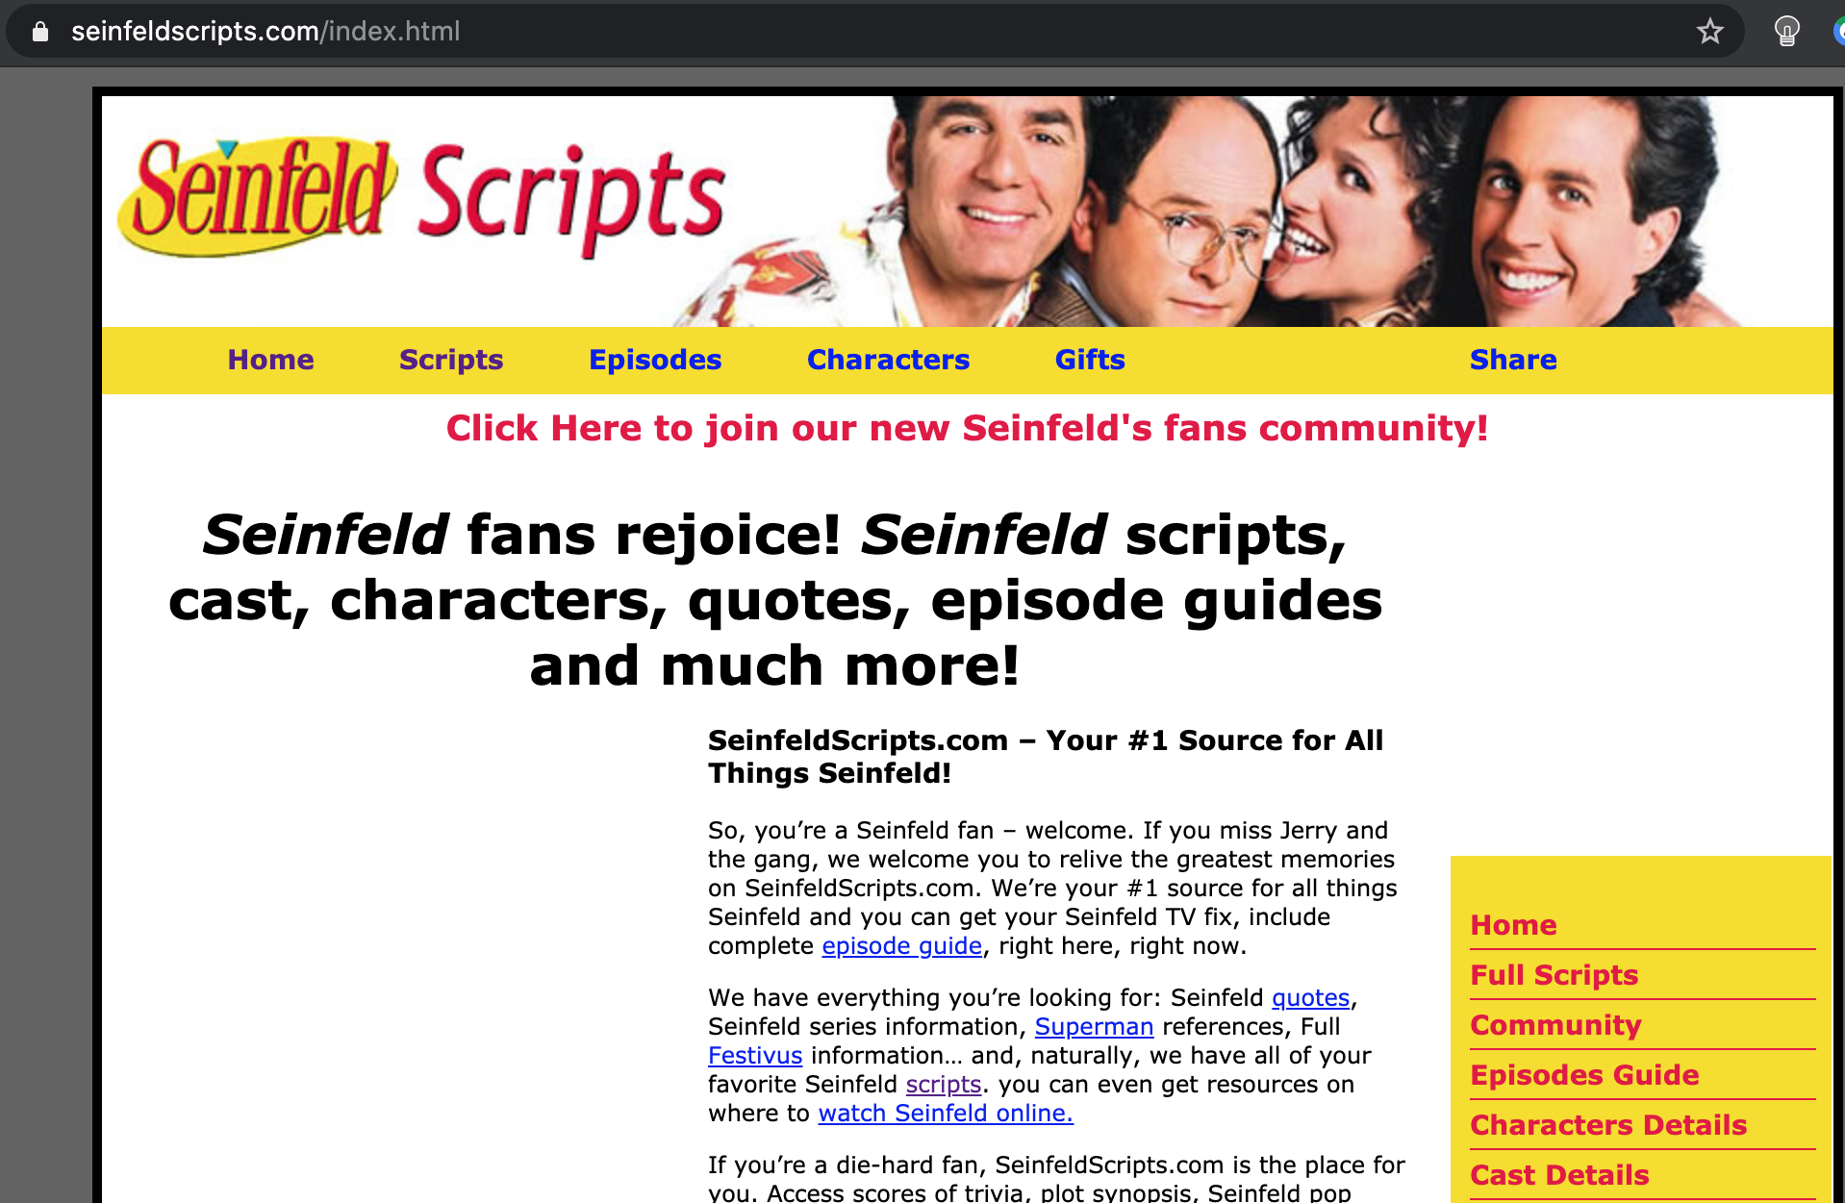
The Data of Seinology
Hugely Popular Sitcom
Enormous Fan Base
Easy to Find Data

Slide 5
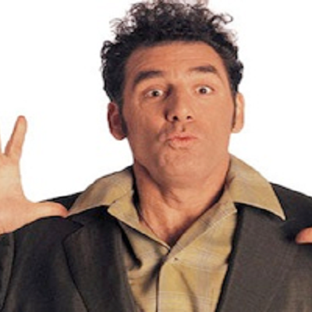
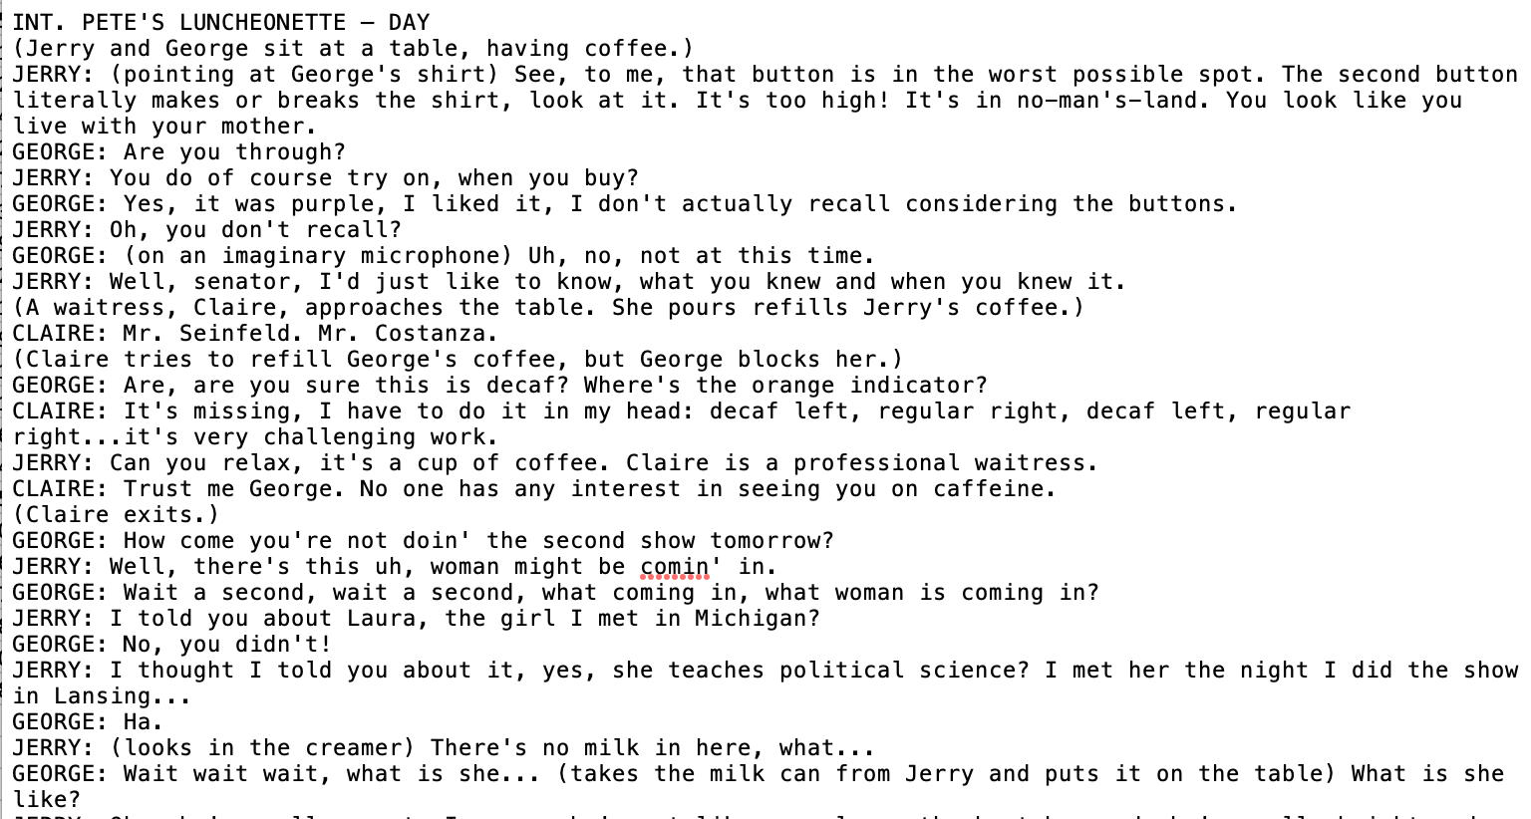
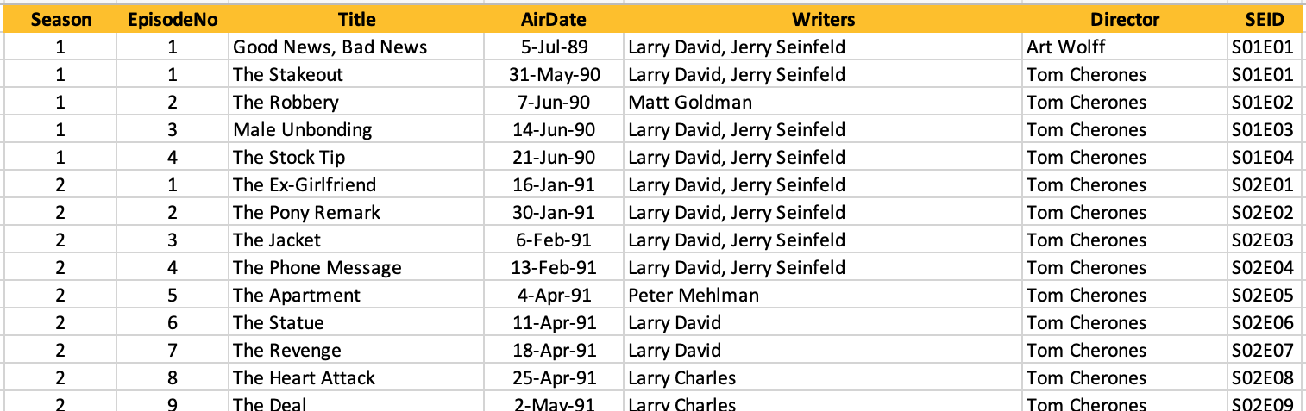
Scripts, Writers, Directors, You Name It…
I’m Out There, Jerry, and I’m Lovin’ Every Minute of It!

Slide 6
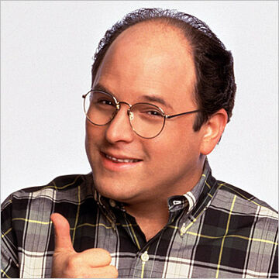
Some Quick Stats…
Remember.. It’s Not a Lie if You Believe it.
9 Seasons (1989-1998)
9 Directors
40 Writers
179 Episodes
1,088 Characters
48,793 Lines of Dialogue

Slide 7
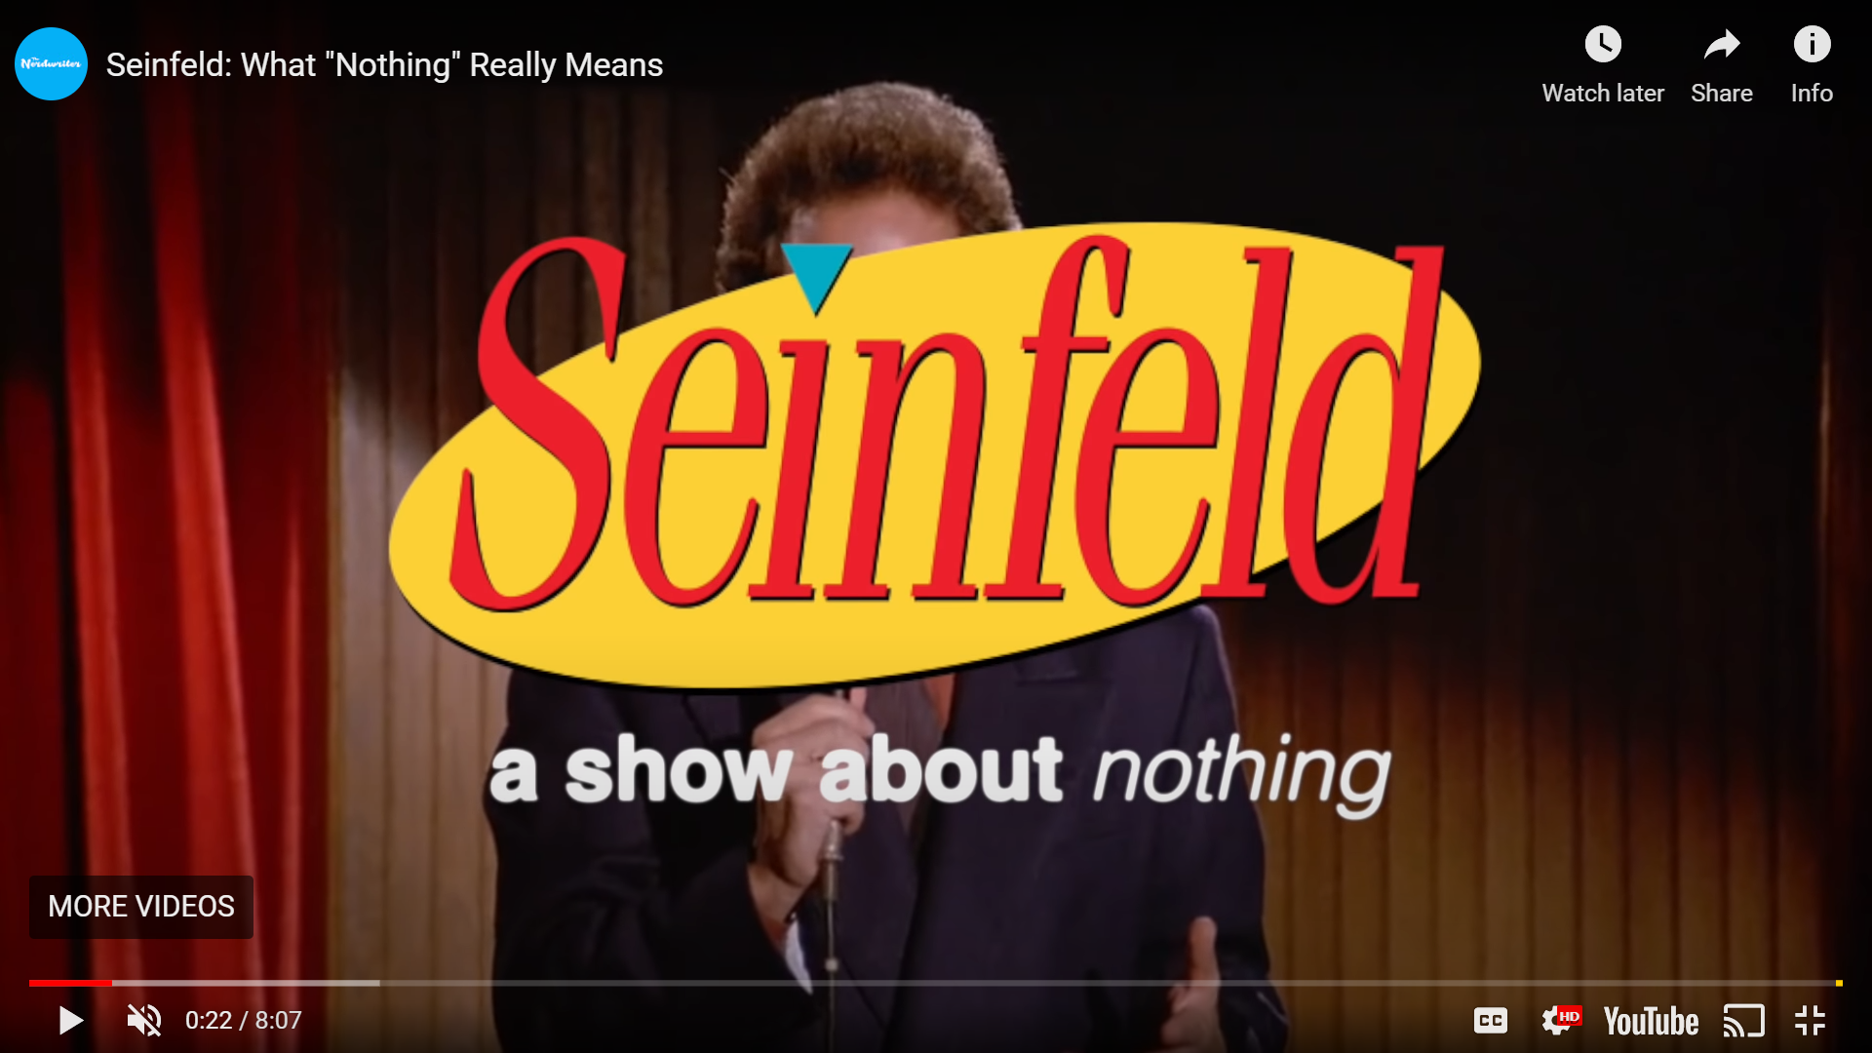
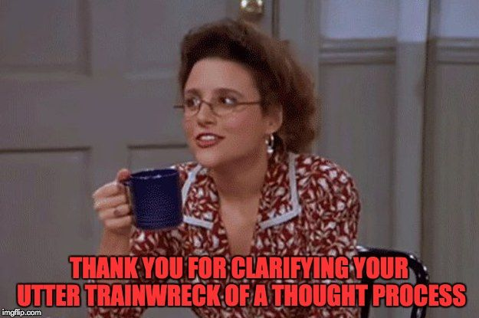
Is it really a show about nothing?

Slide 8




Who said it?
JERRY
GEORGE
KRAMER
ELAINE

Slide 9

Ratings? Writers? Relevance?
Among the 40 writers do any have a measurable style?
Larry David?
Pete Mehlman?
Larry Charles?
Jerry Seinfeld?
Notes:
Can the dialogue / scripts contain words that correspond to a writer's style? Macro scale can style be found when looking at the episodes as a whole? Micro scale can a model be accurate enough to identify what writer wrote a specific line of dialogue?
Do writers favor or ignore writing for certain characters?
Not applicable really for the one-episode writers. But especially applicable for Larry David, he wrote or co-wrote almost half of all episodes. Top four writers who have written or co-written episodes:
Larry David
Pete Mehlman
Larry Charles
Jerry Seinfeld
Surely, they must have a style in the way they write dialogue, maybe even different styles for different characters.

Slide 10
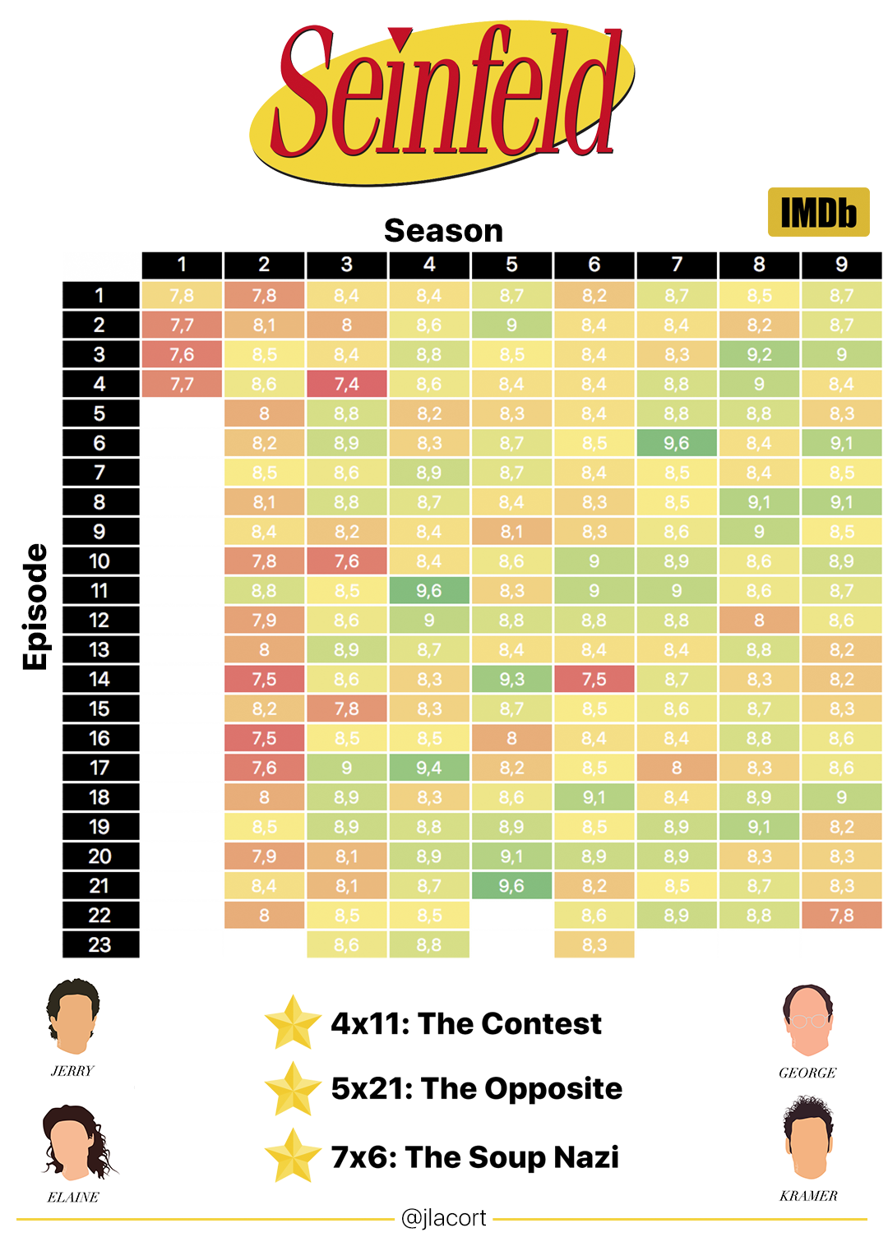
Who’s the best?
Most highly rated character?
Most highly rated writer?
Side character?
Etc.
Notes:
Are there correlations between the rating of a particular episode and the characters ‘most featured’ in the episode. Are there correlations with the amount of dialogue a character has and ratings?
Are there correlations between rating and the writer of the episode?
Much much deeper does a particular writer write one characters dialogue better than others?

Slide 11
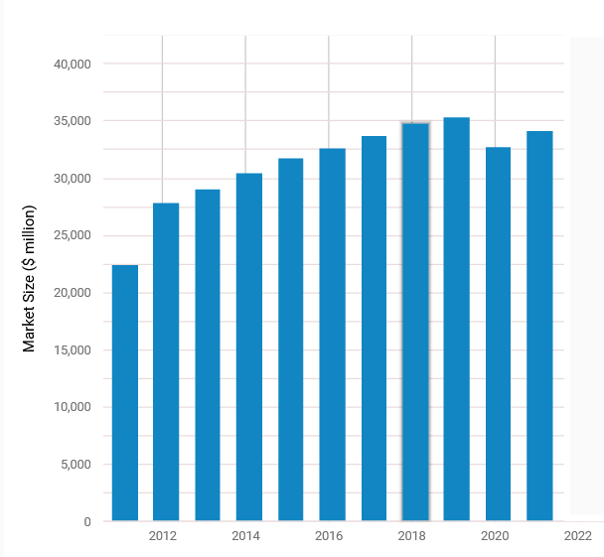
WHY IT MATTERS
Seinfeld the show generated over $3.1 Billion dollars in revenue
Jerry Seinfeld made over $1 Million dollars per episode in the last season
The television production market is forecasted to generate over $34.2 Billion in revenue in 2021
65% of new TV shows are cancelled in their first season

Slide 12
References
https://www.cheatsheet.com/entertainment/the-seinfeld-cast-demanded-1-million-per-episode-to-make-up-for-royalties-they-were-denied.html/
https://www.ibisworld.com/industry-statistics/market-size/television-production-united-states/
https://screenrant.com/tv-success-rate-canceled-shows/
https://www.ceros.com/originals/breaking-down-seinfeld/
https://www.vox.com/2014/7/6/5874267/how-seinfeld-changed-tv-30th-anniversary
https://www.cheatsheet.com/entertainment/the-seinfeld-cast-demanded-1-million-per-episode-to-make-up-for-royalties-they-were-denied.html/
https://www.ibisworld.com/industry-statistics/market-size/television-production-united-states/
https://screenrant.com/tv-success-rate-canceled-shows/
https://www.nydailynews.com/entertainment/tv/10-love-lucy-article-1.2397434

Slide 13

Thank you
Group 4 (in order of appearance)
Stephanie Azali
Juan Ventosa
Mickey Feliciano
John Leo Bartlett
Christopher Bailey

